Slide 1
Unit i
Web Essentials: Clients, Servers and Communication

Slide 2
Basic Internet Protocols
The Internet Protocol (IP) is the method or protocol by which data is sent from one computer to another on the Internet. Each computer (known as a host) on the Internet has at least one IP address that uniquely identifies it from all other computers on the Internet.
When you send or receive data (for example, an e-mail note or a Web page), the message gets divided into little chunks called packets. Each of these packets contains both the sender's Internet address and the receiver's address. Any packet is sent first to a gateway computer that understands a small part of the Internet. The gateway computer reads the destination address and forwards the packet to an adjacent gateway that in turn reads the destination address and so forth across the Internet until one gateway recognizes the packet as belonging to a computer within its immediate neighborhood or domain. That gateway then forwards the packet directly to the computer whose address is specified.

Slide 3
1. Transmission Control Protocol (TCP)
TCP is a connection oriented protocol and offers end-to-end packet delivery. It acts as back bone for connection. It exhibits the following key features:
Transmission Control Protocol (TCP) corresponds to the Transport Layer of OSI Model.
TCP offers following services :
1. Stream Delivery Service- it allows the sending process to send data as stream of bytes and the receiving process to obtain data as stream of bytes.
2. Sending and Receiving Buffers- needs buffers for storage at sending and receiving ends.
3. Bytes and Segments-at transport layer groups the bytes into a packet. This packet is called segment
4. Full Duplex Service- flow of data in both the directions at the same time.
5. Connection Oriented Service-After completing the data exchange, when buffers on both sides are empty, the two TCP’s destroy their buffers.

Slide 4
2. Internet Protocol (IP)
Internet Protocol is connectionless and unreliable protocol. It ensures no guarantee of successfully transmission of data.
In order to make it reliable, it must be paired with reliable protocol such as TCP at the transport layer.
Points to remember:
The length of datagram is variable.
The Datagram is divided into two parts: header and data.
The length of header is 20 to 60 bytes.
The header contains information for routing and delivery of the packet.

Slide 5
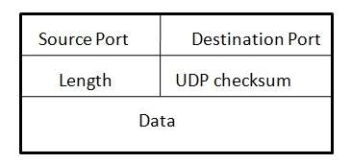
3. User Datagram Protocol (UDP)
Like IP, UDP is connectionless and unreliable protocol. It doesn’t require making a connection with the host to exchange data. Since UDP is unreliable protocol, there is no mechanism for ensuring that data sent is received.
UDP is used by the application that typically transmit small amount of data at one time.
UDP transmits the data in form of a datagram. The UDP datagram consists of five parts as shown in the following diagram:

Slide 6
4. File Transfer Protocol (FTP)
FTP is used to copy files from one host to another.
FTP creates two processes such as Control Process and Data Transfer Process at both ends i.e. at client as well as at server.
Control connection is made between control processes while Data Connection is made between
FTP uses port 21 for the control connection and Port 20 for the data connection.

Slide 7
5. E-mail Protocols
E-mail Protocols are set of rules that help the client to properly transmit the information to or from the mail server. It contains various protocols such as SMTP, POP, and IMAP.
A. SMTP
SMTP stands for Simple Mail Transfer Protocol. It was first proposed in 1982. It is a standard protocol used for sending e-mail efficiently and reliably over the internet.
SMTP is text based and connection oriented protocol.
In case, message cannot be delivered, an error report is sent to the sender which makes SMTP a reliable protocol.

Slide 8
6. E-mail Protocols (cond..)
B. IMAP
IMAP stands for Internet Mail Access Protocol. It was first proposed in 1986.
IMAP allows the client program to manipulate the e-mail message on the server without downloading them on the local computer.
The e-mail is hold and maintained by the remote server.
IMAP enables the users to search the e-mails.
C. POP
POP stands for Post Office Protocol. It is generally used to support a single client. There are several versions of POP but the POP 3 is the current standard.
Since POP supports offline access to the messages, thus requires less internet usage time.

Slide 9
6. Hyper Text Transfer Protocol (HTTP)
HTTP is a communication protocol. It defines mechanism for communication between browser and the web server. It is also called request and response protocol because the communication between browser and server takes place in request and response pairs. This is the foundation for data communication for the World Wide Web (i.e. internet) since 1990.
HTTP is connectionless: The HTTP client, i.e., a browser initiates an HTTP request and after a request is made, the client disconnects from the server and waits for a response. The server processes the request and re-establishes the connection with the client to send a response back.
HTTP is media independent: It means, any type of data can be sent by HTTP as long as both the client and the server know how to handle the data content. It is required for the client as well as the server to specify the content type using appropriate MIME-type.
HTTP is stateless: As mentioned above, HTTP is connectionless and it is a direct result of HTTP being a stateless protocol. The server and client are aware of each other only during a current request. Afterwards, both of them forget about each other. Due to this nature of the protocol, neither the client nor the browser can retain information between different requests across the web pages.

Slide 10
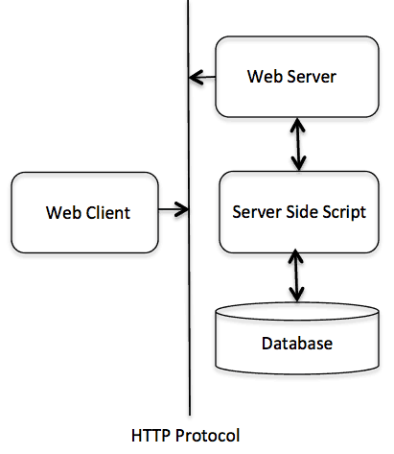
6. Basic Architecture
The HTTP protocol is a request/response protocol based on the client/server based architecture where web browsers, robots and search engines, etc. act like HTTP clients, and the Web server acts as a server.
Client-The HTTP client sends a request to the server in the form of a request method, URI, and protocol version, followed by a MIME-like message containing request modifiers, client information, and possible body content over a TCP/IP connection.
Server-The HTTP server responds with a status line, including the message's protocol version and a success or error code, followed by a MIME-like message containing server information, entity meta information, and possible entity-body content.

Slide 11
6. HTTP - Messages
An HTTP "client" is a program (Web browser or any other client) that establishes a connection to a server for the purpose of sending one or more HTTP request messages. An HTTP "server" is a program ( generally a web server like Apache Web Server or Internet Information Services IIS, etc. ) that accepts connections in order to serve HTTP requests by sending HTTP response messages.
HTTP makes use of the Uniform Resource Identifier (URI) to identify a given resource and to establish a connection. Once the connection is established, HTTP messages are passed in a format similar to that used by the Internet mail [RFC5322] and the Multipurpose Internet Mail Extensions (MIME) [RFC2045]. These messages include requests from client to server and responses from server to client which will have the following format:
HTTP-message = <Request> | <Response> ; HTTP/1.1 messages

Slide 12
Contd…
HTTP requests and HTTP responses use a generic message format of RFC 822 for transferring the required data. This generic message format consists of the following four items.
1. Message Start-Line
start-line = Request-Line | Status-Line
examples of start line in case of request and response:
GET /hello.htm HTTP/1.1 (This is Request-Line sent by the client)
HTTP/1.1 200 OK (This is Status-Line sent by the server)
2. Header Fields
HTTP header fields provide required information about the request or response, or about the object sent in the message body. There are four types of HTTP message headers:

Slide 13
2.Header Fields (Contd..)
General-header: These header fields have general applicability for both request and response messages.
Request-header: These header fields have applicability only for request messages.
Response-header: These header fields have applicability only for response messages.
Entity-header: These header fields define meta information about the entity-body or, if nobody is present, about the resource identified by the request.
Syntax: message-header = field-name ":" [ field-value ]
Example: Host: www.example.com
Date: Mon, 27 Jul 2009 12:28:53 GMT
Server: Apache
Last-Modified: Wed, 22 Jul 2009 19:15:56 GMT

Slide 14
3. Message Body
The message body part is optional for an HTTP message but if it is available, then it is used to carry the entity-body associated with the request or response. If entity body is associated, then usually Content-Type and Content-Length headers lines specify the nature of the body associated.
A message body is the one which carries the actual HTTP request data (including form data and uploaded, etc.) and HTTP response data from the server ( including files, images, etc.). Shown below is the simple content of a message body:
<html>
<body>
<h1>Hello, World!</h1>
</body>
</html>

Slide 15
HTTP - Requests
1. Request-Line
The Request-Line begins with a method token, followed by the Request-URI and the protocol version, and ending with CRLF. The elements are separated by space SP characters.
Request-Line = Method SP Request-URI SP HTTP-Version CRLF
Request Method: The request method indicates the method to be performed on the resource identified by the given Request-URI. The method is case-sensitive and should always be mentioned in uppercase. The following table lists all the supported methods in HTTP/1.1.

Slide 16
Contd…
S.N. | Method and Description
1 | GET - The GET method is used to retrieve information from the given server using a given URI. Requests using GET should only retrieve data and should have no other effect on the data.
2 | HEAD - Same as GET, but it transfers the status line and the header section only.
3 | POST - A POST request is used to send data to the server, for example, customer information, file upload, etc. using HTML forms.
4 | PUT - Replaces all the current representations of the target resource with the uploaded content.
5 | DELETE - Removes all the current representations of the target resource given by URI.
6 | CONNECT - Establishes a tunnel to the server identified by a given URI.
7 | OPTIONS - Describe the communication options for the target resource.
8 | TRACE - Performs a message loop back test along with the path to the target resource.

Slide 17
2. Request Header Fields
The request-header fields allow the client to pass additional information about the request, and about the client itself, to the server. These fields act as request modifiers. Here is a list of some important Request-header fields that can be used based on the requirement:
Accept-Charset, Accept-Encoding, Accept-Language, Authorization, Expect, From, Host, If-Match, If-Modified-Since, If-None-Match, If-Range, If-Unmodified-Since, Max-Forwards, Proxy-Authorization, Range, Referrer, TE, User-Agent
The following example shows how to send form data to the server using request message body:

Slide 18
Example(contd..)
POST /cgi-bin/process.cgi HTTP/1.1
User-Agent: Mozilla/4.0 (compatible; MSIE5.01; Windows NT)
Host: www.tutorialspoint.com
Content-Type: application/x-www-form-urlencoded
Content-Length: length
Accept-Language: en-us
Accept-Encoding: gzip, deflate
Connection: Keep-Alive
licenseID=string&content=string&/paramsXML=string

Slide 19
HTTP - Responses
After receiving and interpreting a request message, a server responds with an HTTP response message:
A Status-line
Zero or more header (General|Response|Entity) fields followed by CRLF
An empty line (i.e., a line with nothing preceding the CRLF) indicating the end of the header fields
Optionally a message-body

Slide 20
Example(contd..)
1. Message Status-Line
A Status-Line consists of the protocol version followed by a numeric status code and its associated textual phrase. The elements are separated by space SP characters.
Status-Line = HTTP-Version SP Status-Code SP Reason-Phrase CRLF
HTTP Version
A server supporting HTTP version 1.1 will return the following version information:
HTTP-Version = HTTP/1.1
Status Code
The Status-Code element is a 3-digit integer where first digit of the Status-Code defines the class of response and the last two digits do not have any categorization role. There are 5 values for the first digit:

Slide 21
(contd..)
S.N. | Code and Description
1 | 1xx: Informational It means the request was received and the process is continuing.
2 | 2xx: Success It means the action was successfully received, understood, and accepted.
3 | 3xx: Redirection It means further action must be taken in order to complete the request.
4 | 4xx: Client Error It means the request contains incorrect syntax or cannot be fulfilled.
5 | 5xx: Server Error It means the server failed to fulfill an apparently valid request.

Slide 22
Response Header Fields
1. The response-header fields allow the server to pass additional information about the response which cannot be placed in the Status- Line. These header fields give information about the server and about further access to the resource identified by the Request-URI.
Accept-Ranges, Age, Etag, Location, Proxy-Authenticate, Retry-After, Server, Vary, WWW-Authenticate
Examples of Response Message
HTTP/1.1 200 OK
Date: Mon, 27 Jul 2009 12:28:53 GMT
Server: Apache/2.2.14 (Win32)
Last-Modified: Wed, 22 Jul 2009 19:15:56 GMT
Content-Length: 88
Content-Type: text/html
Connection: Closed

Slide 23
Different Architecture of connection
Client Server Architecture
Client-server architecture (client/server) is a network architecture in which each computer or process on the network is either a client or a server. Servers are powerful computers or processes dedicated to managing disk drives (file servers), printers (print servers), or network traffic (network servers ). Clients are PCs or workstations on which users run applications. Clients rely on servers for resources, such as files, devices, and even processing power.
2. Peer to Peer Architecture
A type of network in which each workstation has equivalent capabilities and responsibilities. This differs from client/server architectures, in which some computers are dedicated to serving the others. Peer-to-peer networks are generally simpler, but they usually do not offer the same performance under heavy loads.

Slide 24
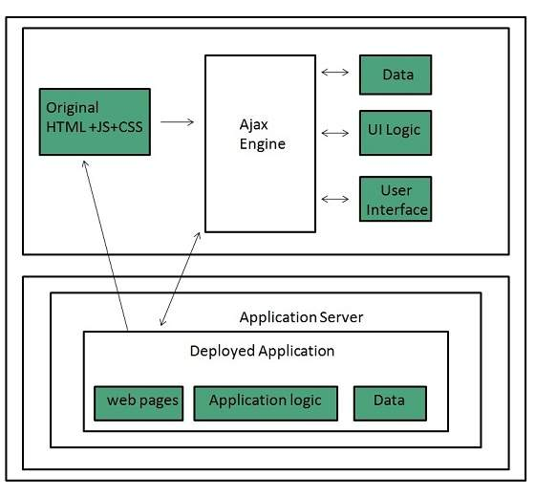
Client-side Scripting
Client-side scripting refers to the programs that are executed on client-side. Client-side scripts contains the instruction for the browser to be executed in response to certain user’s action.
Client-side scripting programs can be embedded into HTML files or also can be kept as separate files.

Slide 25
Client-side Scripting(contd..)
1. Following table describes commonly used Client-Side scripting languages:
S.N. | Scripting Language Description
1. | JavaScript It is a prototype based scripting language. It inherits its naming conventions from java. All java script files are stored in file having .js extension.
2. | ActionScriptIt is an object oriented programming language used for the development of websites and software targeting Adobe flash player.
3. | Dart It is an open source web programming language developed by Google. It relies on source-to-source compiler to JavaScript.
4. | VBScript It is an open source web programming language developed by Microsoft. It is superset of JavaScript and adds optional static typing class-based object oriented programming.

Slide 26
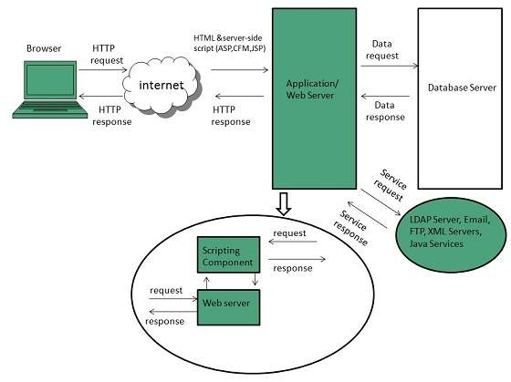
Server-side Scripting
Sever-side scripting acts as an interface for the client and also limit the user access the resources on web server. It can also collects the user’s characteristics in order to customize response.

Slide 27
Client-side Scripting
S.N. | Scripting Language Description
1. | ASP Active Server Pages (ASP)is server-side script engine to create dynamic web pages. It supports Component Object Model (COM) which enables ASP web sites to access functionality of libraries such as DLL.
3. | ASP.net It is used to develop dynamic websites, web applications, and web services.
4. | Java Java Server Pages are used for creating dynamic web applications. The Java code is compiled into byte code and run by Java Virtual Machine (JVM).
5. | Python It supports multiple programming paradigms such as object-oriented, and functional programming. It can also be used as non-scripting language using third party tools such as Py2exe or Pyinstaller.
6. | PHP It is an open source server-side scripting language.

Slide 28
Web Browser
web Browser is an application software that allows us to view and explore information on the web. User can request for any web page by just entering a URL into address bar.
Web browser can show text, audio, video, animation and more. It is the responsibility of a web browser to interpret text and commands contained in the web page.
Earlier the web browsers were text-based while now a days graphical-based or voice-based web browsers are also available.

Slide 29
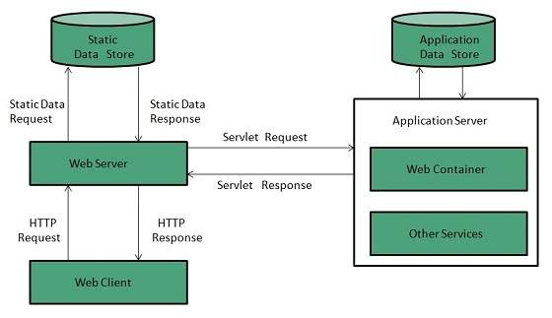
Web Server
Web server is a computer where the web content is stored. Basically web server is used to host the web sites but there exists other web servers also such as gaming, storage, FTP, email etc.
Web site is collection of web pages while web server is a software that respond to the request for web resources.

Slide 30
Thank you

